Slide 1
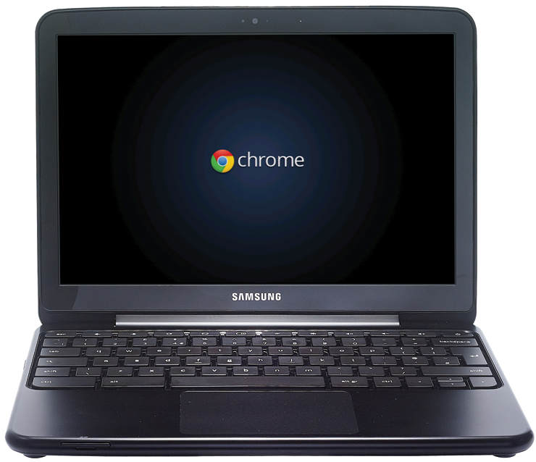
Rules for Using
Chromebooks

Slide 2
1. Always sit down while using the Chromebooks.

Slide 3
2. If you are asked to move for any reason, carry the Chromebook with two hands and hold the Chromebook by the base, not the cover.

Slide 4
3. No banging, slamming, or hitting the Chromebook.

Slide 5
4. Stay focused on the activity, and raise your hand if you need help.

Slide 6
5. Do not visit pages that are not directly related to your assignment.

Slide 7
5. Do not touch someone else’s Chromebook.

Slide 8
7. No gum, food, or drinks allowed.

Slide 9
8. Stop when directed and shut down before closing the Chromebook.

Slide 10
The Rules Are:
1. Always sit down while using the Chromebooks.
2. If you are asked to move for any reason, carry the Chromebook with two hands and hold the Chromebook by the base, not the cover.
3. No banging, slamming, or hitting the Chromebook.
4. Stay focused on the activity, and raise your hand if you need help.
5. Do not visit pages that are not directly related to your assignment.
6. Do not touch someone else’s Chromebook.
7. No gum, food, or drinks allowed.
8. Stop when directed and shut down before closing the Chromebook.

Slide 11
The Rules Are:
1. Always sit down while using the Chromebooks.
2. If you are asked to move for any reason, carry the Chromebook with two hands and hold the Chromebook by the base, not the cover.
3. No banging, slamming, or hitting the Chromebook.
4. Stay focused on the activity, and raise your hand if you need help.
5. Do not visit pages that are not directly related to your assignment.
6. Do not touch someone else’s Chromebook.
7. No gum, food, or drinks allowed.
8. Stop when directed and shut down before closing the Chromebook.
Notes:
Printable copy for student notebooks.

Slide 12
Thank you for downloading. I hope that you enjoy the resource and get a lot of use out of it. Please let me know if you have any questions or concerns. My email address is happyedug8r@msn.com or you can message me via social media.
Commercial Graphics used with permission from the following: Microsoft Design, GraphicStock.com, pixabay.com
For more teaching ideas and freebies, please click on the link to visit my blog! http://www.happyedugator.blogspot.com Also, I would love to have you follow me on Facebook, Instagram, Pinterest, Google +, Twitter, and Linked-In!
Please leave feedback at My TPT Store. http://www.teacherspayteachers.com/Store/HappyEdugator Remember, you will earn credits for leaving me feedback which goes toward any future TPT purchases.
Thank you and happy teaching!
Deborah Hayes
Aka HappyEdugator
This product is the intellectual property of Deborah Hayes aka HappyEdugator. Your purchase buys one license. This resource is for classroom or homeschool use and is intended for the purchaser. Duplication for other classes, for other teachers or for use in wide distribution is not allowed. You may purchase extra licenses at a discount. This material is protected under the Digital Millennium Copyright Act.
©2018 HappyEdugator

